Slide 1
Control System Design Based on Frequency Response Analysis
Frequency response concepts and techniques play an important role in control system design and analysis.
Closed-Loop Behavior
In general, a feedback control system should satisfy the following design objectives:
Closed-loop stability
Good disturbance rejection (without excessive control action)
Fast set-point tracking (without excessive control action)
A satisfactory degree of robustness to process variations and model uncertainty
Low sensitivity to measurement noise

Slide 2
Controller Design Using Frequency Response Criteria
Advantages of FR Analysis:
1. Applicable to dynamic model of any order
(including non-polynomials).
2. Designer can specify desired closed-loop response
characteristics.
3. Information on stability and sensitivity/robustness is provided.
Disadvantage:
The approach tends to be iterative and hence time-consuming
-- interactive computer graphics desirable (MATLAB)
Chapter 14

Slide 3
Complex Variable Z-P=N Theorem
If a complex function F(s) has Z zeros and P poles inside a certain area of the s plane, the number of encirclements (N) a mapping of a closed contour around the area makes in the F plane around the origin is equal to Z-P.

Slide 5
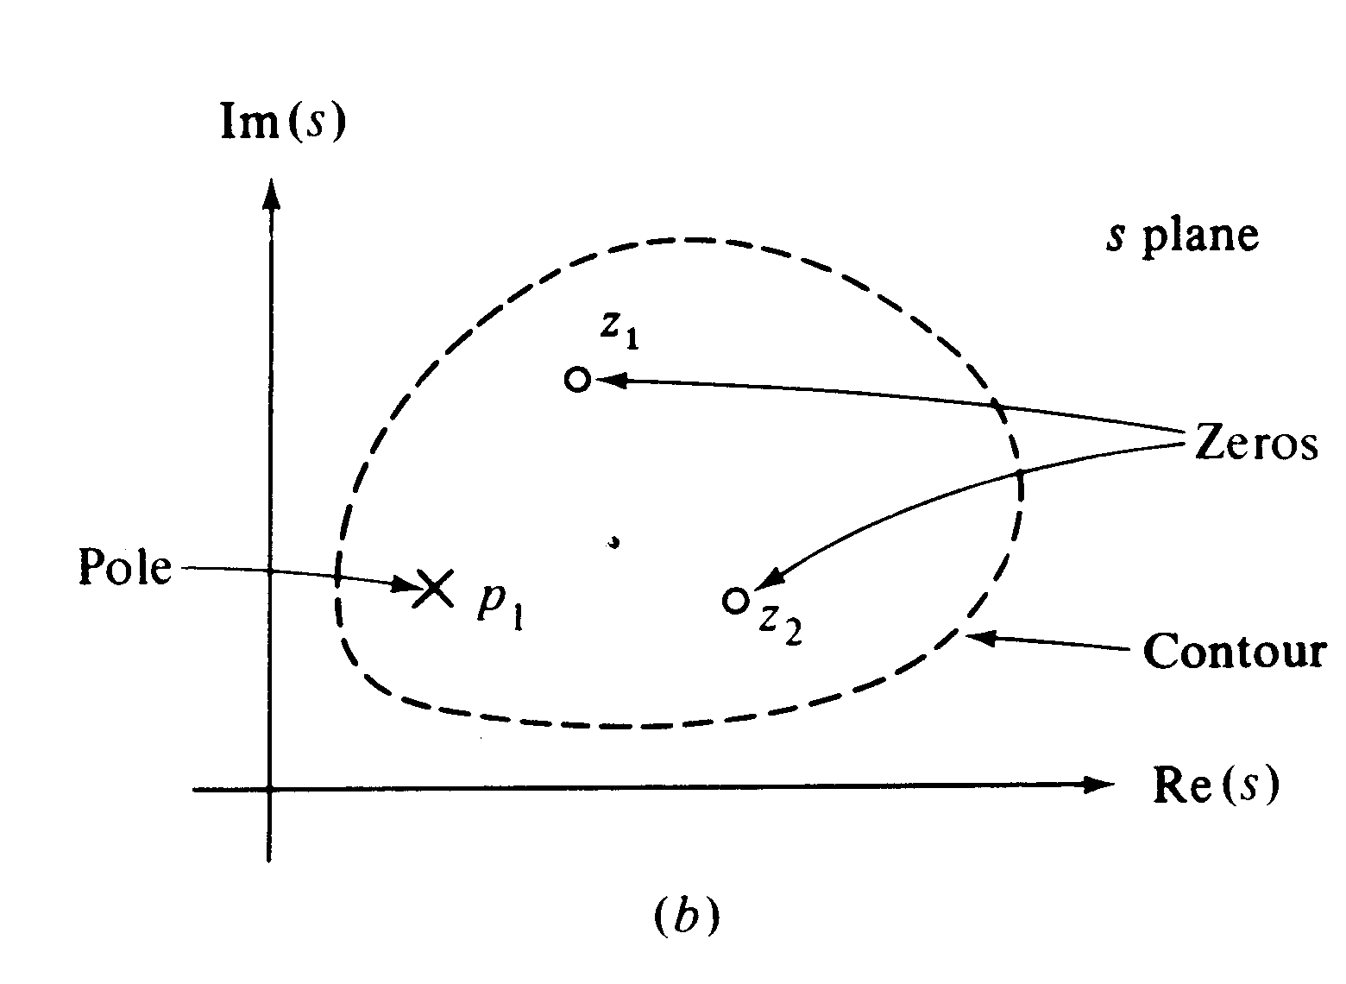

Slide 6
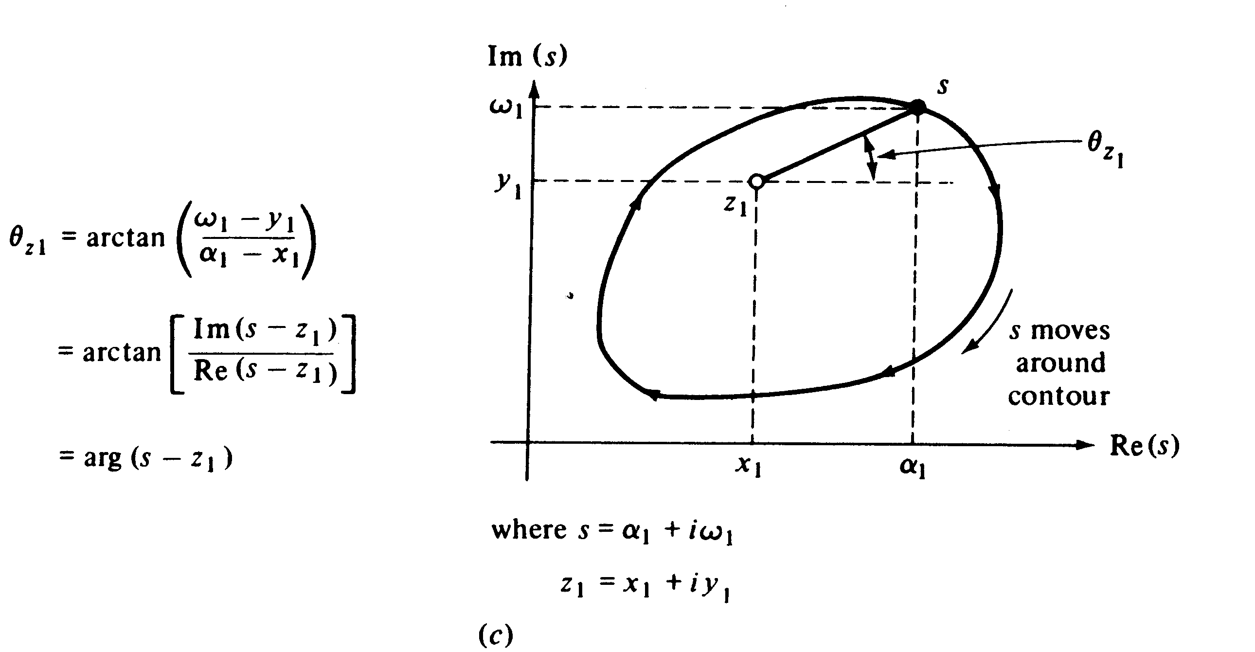

Slide 7
Figure 14.1 Block diagram with a disturbance D and measurement noise N.

Slide 8
Application of Z-P=N Theorem to Stability

Slide 9
Remarks

Slide 10
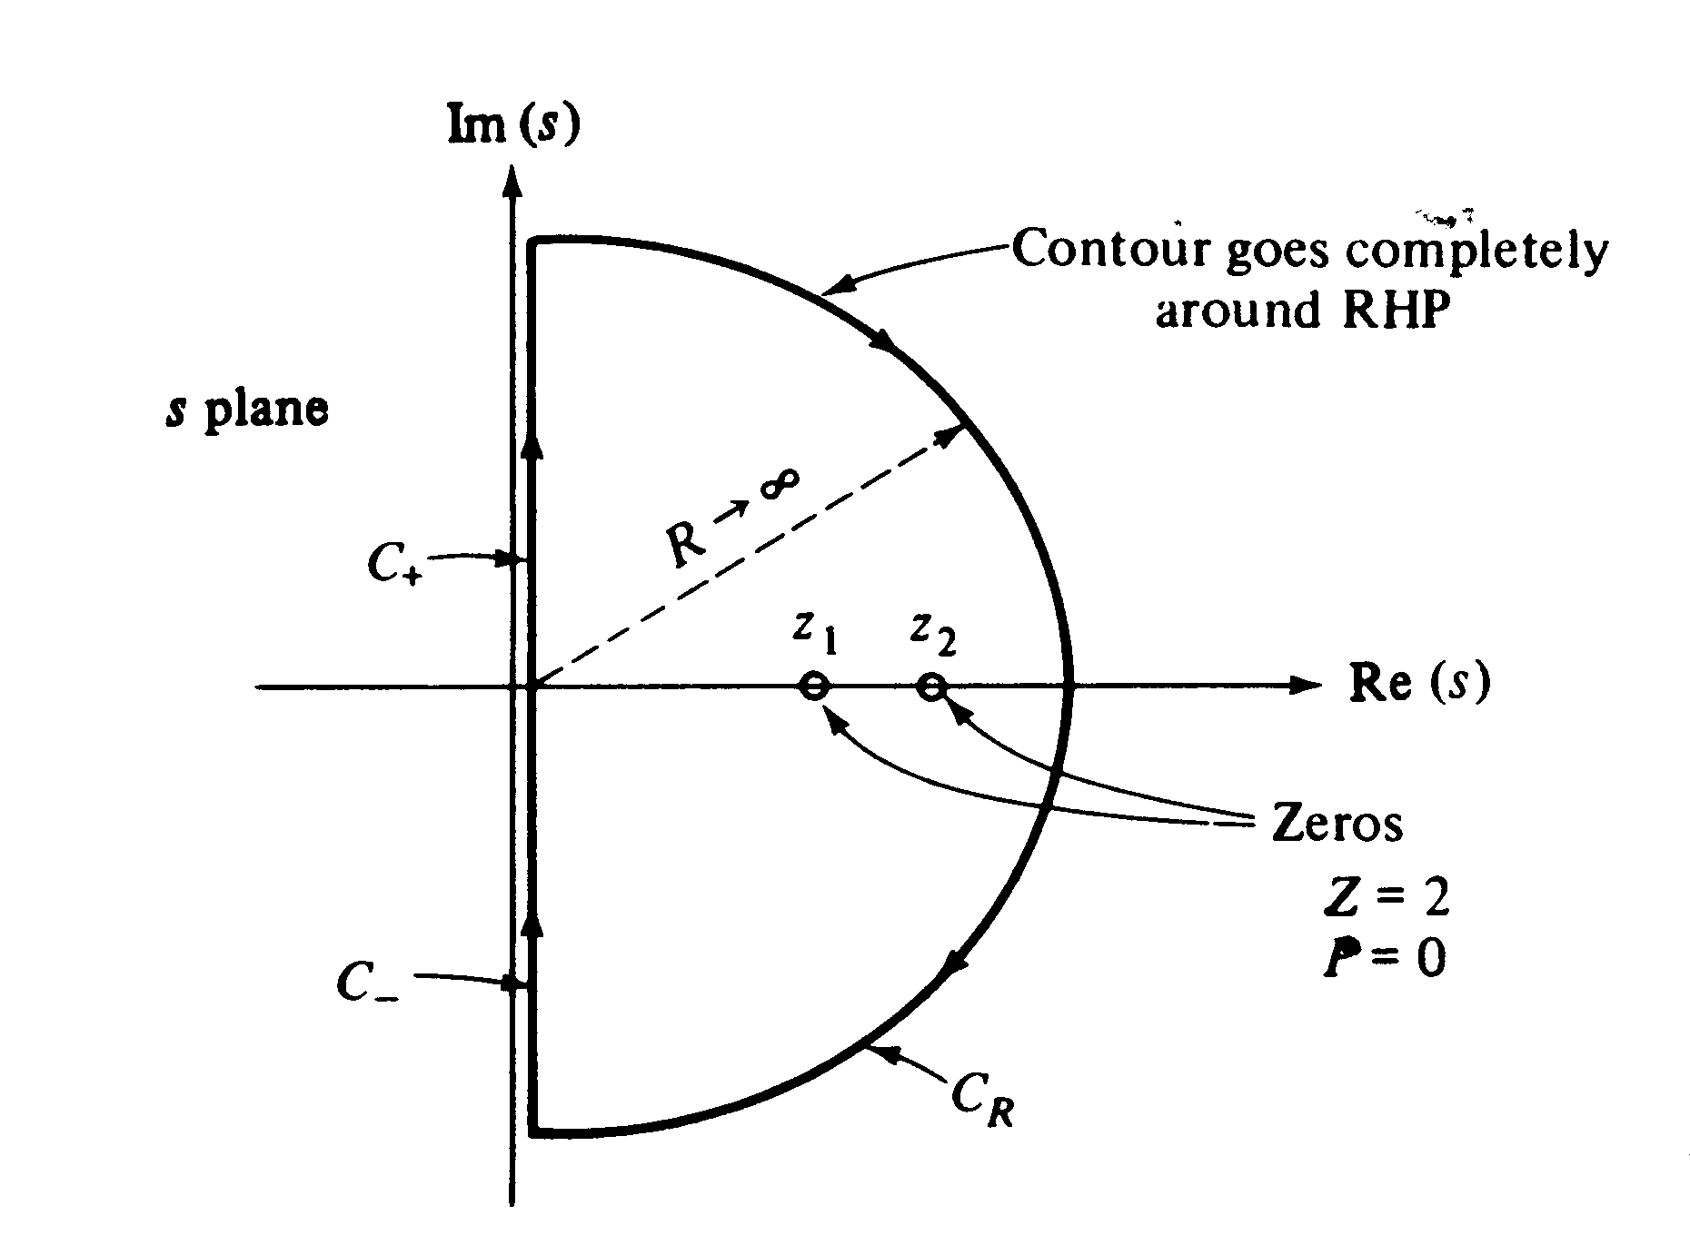

Slide 11
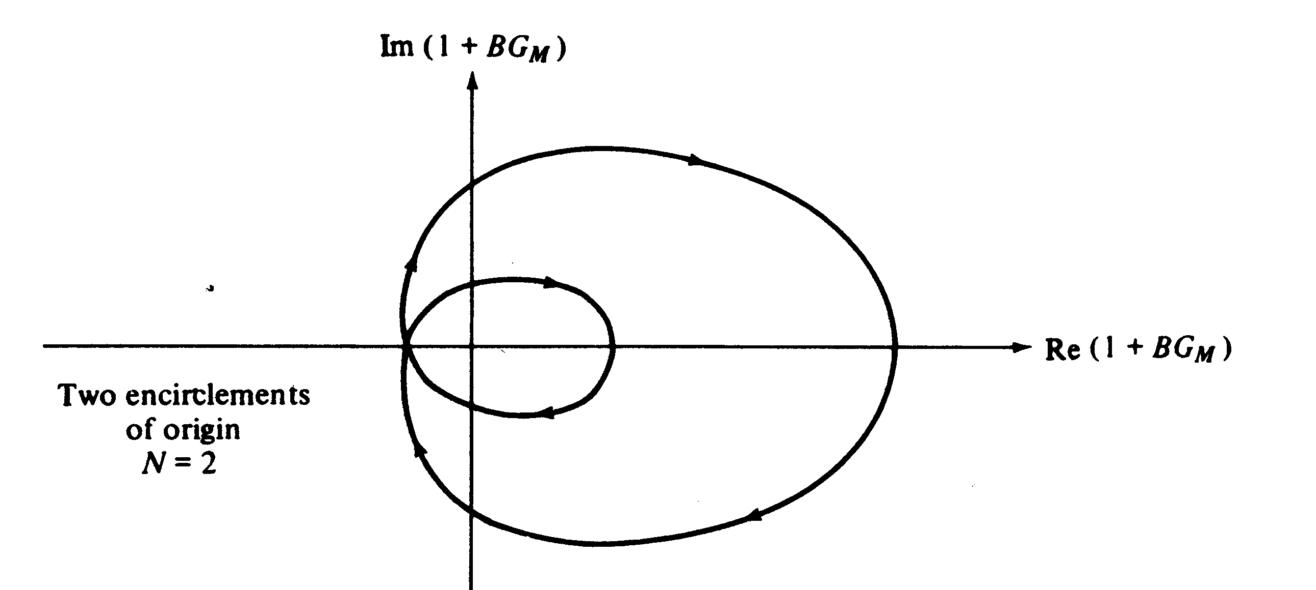

Slide 12
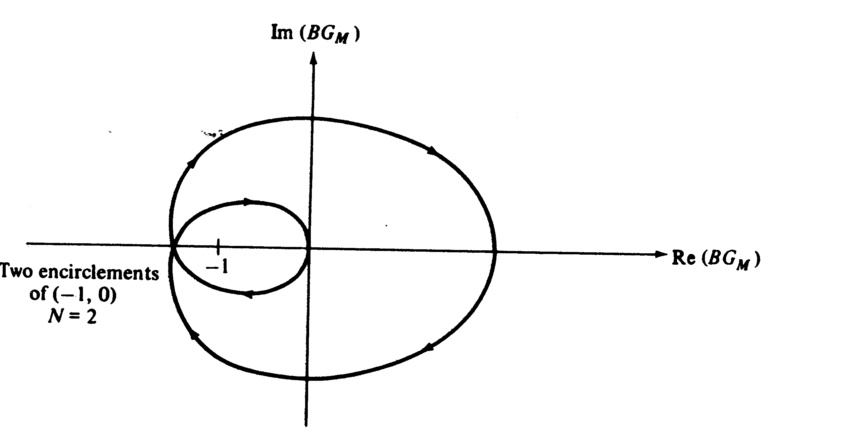

Slide 13
Nyquist Stability Criterion

Slide 14
Example

Slide 16
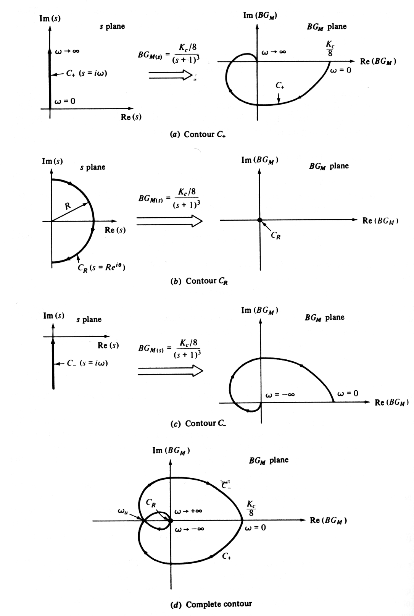

Slide 17
Important Conclusion
The C+ contour, i.e., Nyquist plot, is the only one we need to determine the system stability!

Slide 18
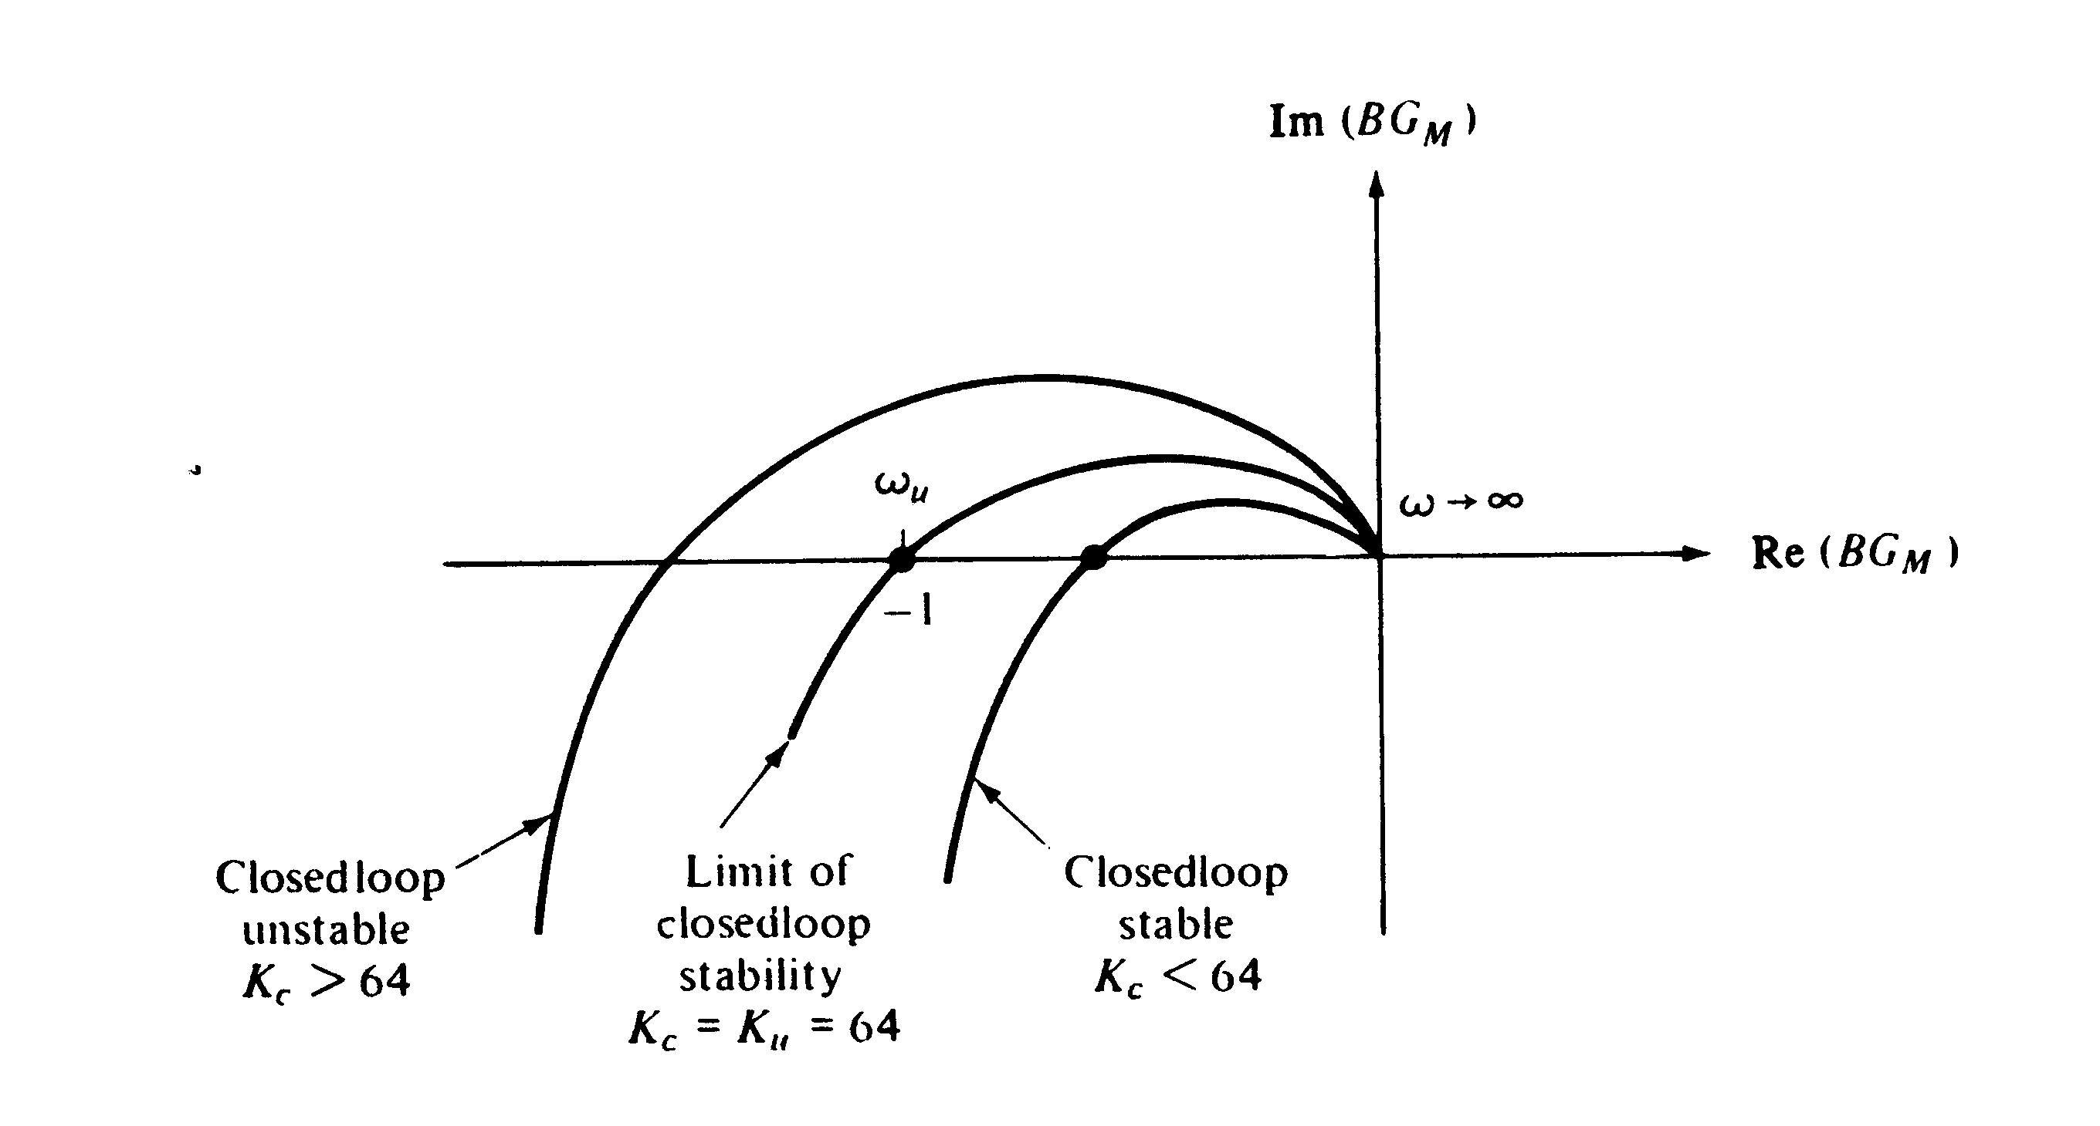

Slide 19
Ultimate Gain and Ultimate Frequency

Slide 20
Example 2

Slide 21
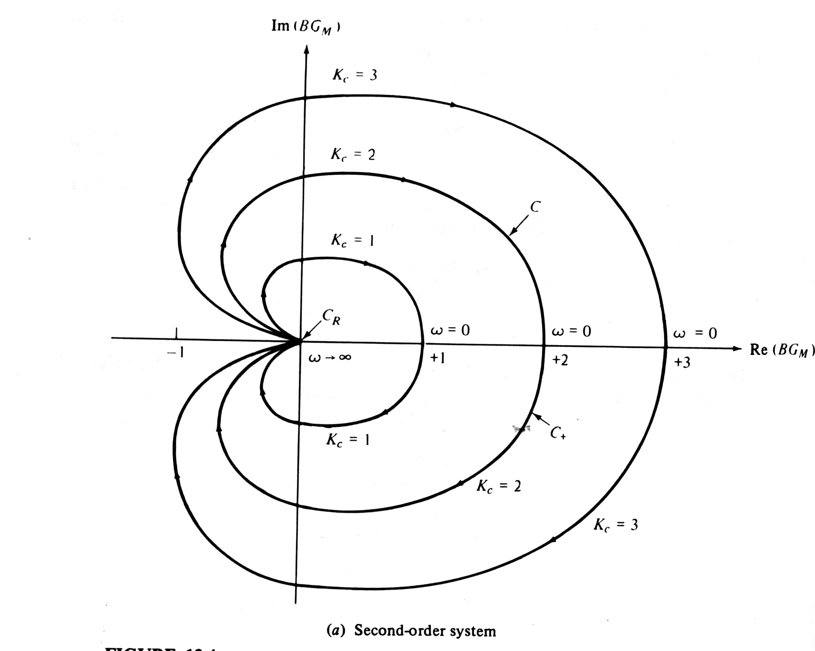
Always Stable!

Slide 22
Example 3

Slide 23
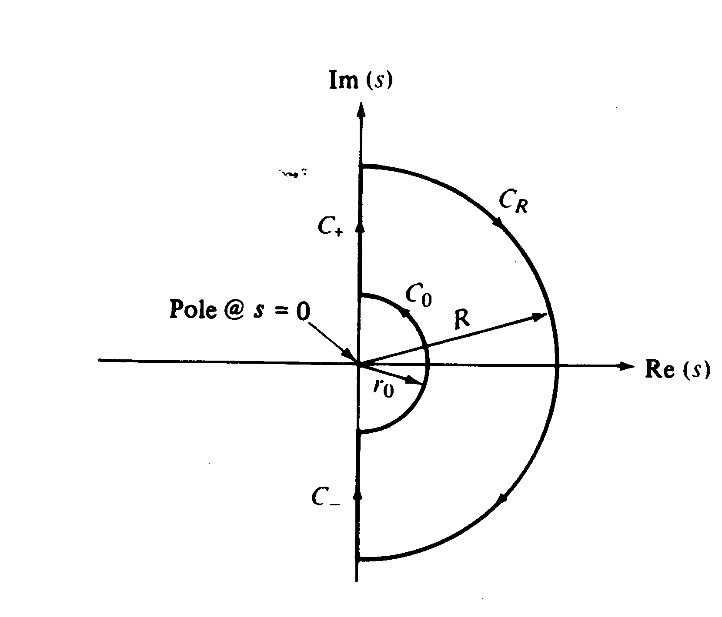

Slide 26
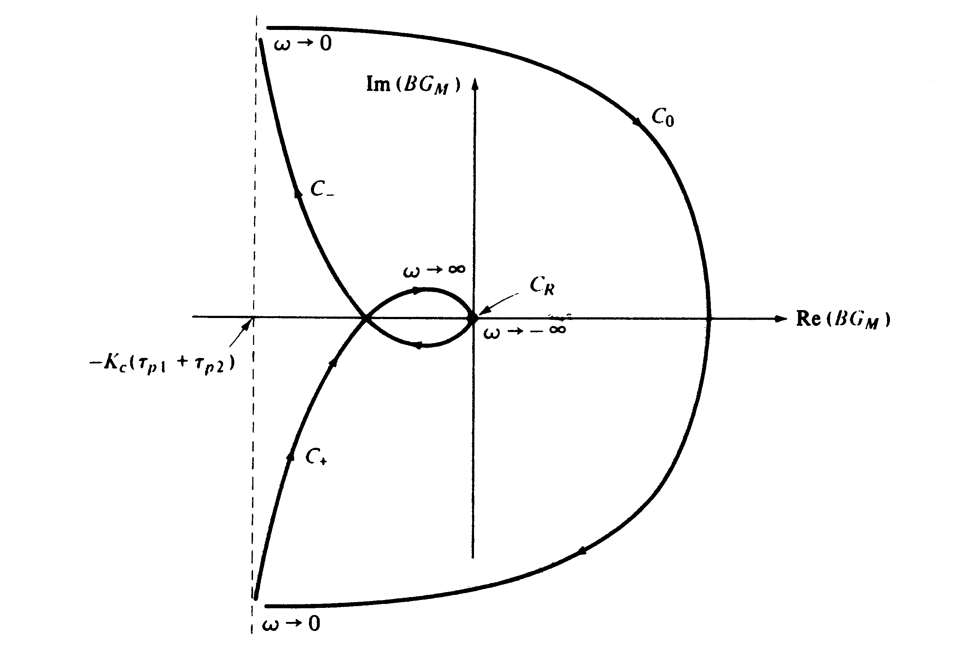

Slide 27
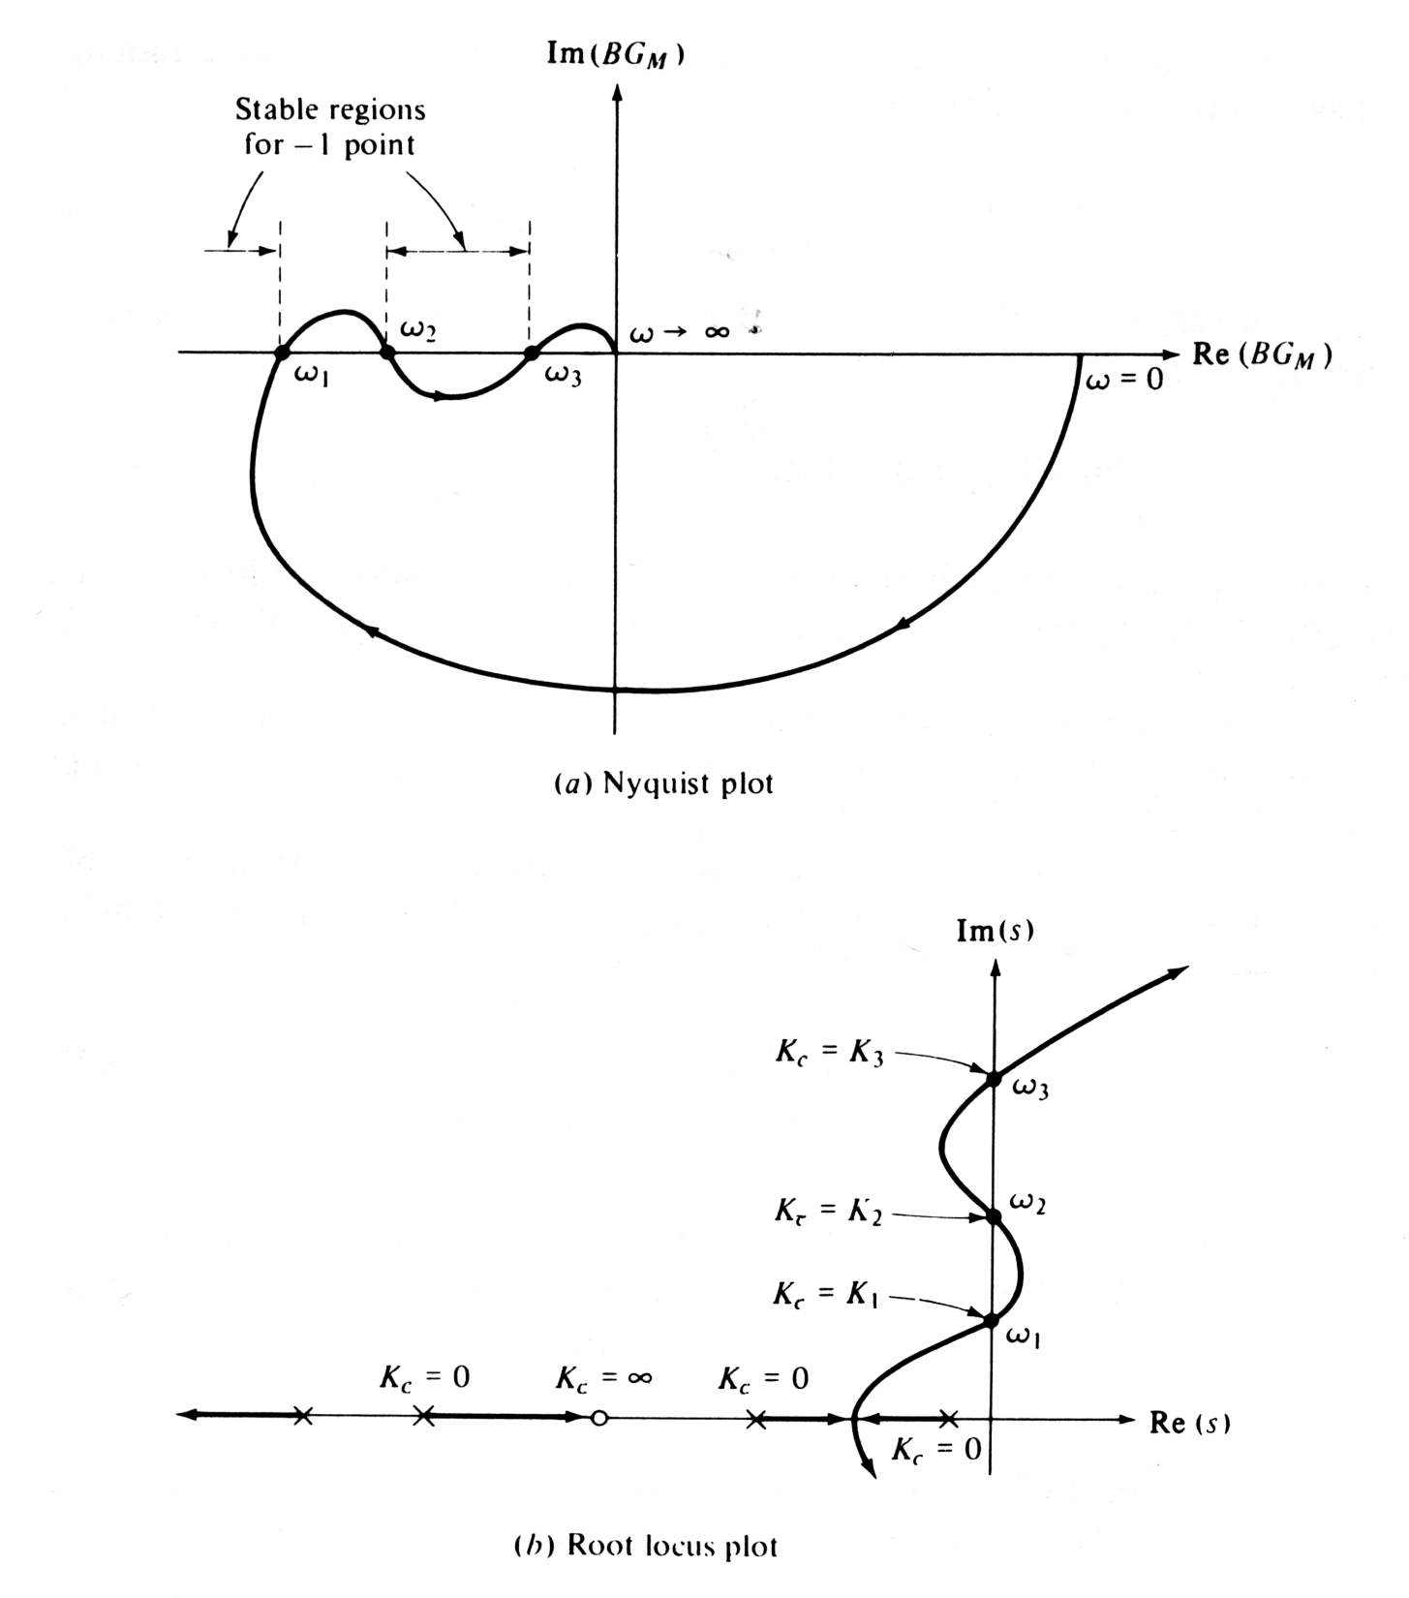

Slide 28
The block diagram of a general feedback control system is shown in Fig. 14.1.
It contains three external input signals: set point Y_{sp}, disturbance D, and additive measurement noise, N.
where G G_{v}G_{p}G_{m}.

Slide 29
Example 14.1
Consider the feedback system in Fig. 14.1 and the following transfer functions:
Suppose that controller G_{c} is designed to cancel the unstable pole in G_{p}:
Evaluate closed-loop stability and characterize the output response for a sustained disturbance.

Slide 30
Solution
The characteristic equation, 1 + G_{c}G = 0, becomes:
or
In view of the single root at s = -2.5, it appears that the closed-loop system is stable. However, if we consider Eq. 14-1 for N = Y_{sp} = 0,

Slide 31
This transfer function has an unstable pole at s = +0.5. Thus, the output response to a disturbance is unstable.
Furthermore, other transfer functions in (14-1) to (14-3) also have unstable poles.
This apparent contradiction occurs because the characteristic equation does not include all of the information, namely, the unstable pole-zero cancellation.
Example 14.2
Suppose that G_{d} = G_{p}, G_{m} = K_{m} and that G_{c} is designed so that the closed-loop system is stable and |GG_{c} | >> 1 over the frequency range of interest. Evaluate this control system design strategy for set-point changes, disturbances, and measurement noise. Also consider the behavior of the manipulated variable, U.

Slide 32
Solution
Because |GG_{c} | >> 1,
The first expression and (14-1) suggest that the output response to disturbances will be very good because Y/D ≈ 0. Next, we consider set-point responses. From Eq. 14-1,
Because G_{m} = K_{m}, G = G_{v}G_{p}K_{m} and the above equation can be written as,

Slide 33
For |GG_{c} | >> 1,
Thus, ideal (instantaneous) set-point tracking would occur. Choosing G_{c} so that |GG_{c}| >> 1 also has an undesirable consequence. The output Y becomes sensitive to noise because Y ≈ - N (see the noise term in Eq. 14-1). Thus, a design tradeoff is required.
Bode Stability Criterion
The Bode stability criterion has two important advantages in comparison with the Routh stability criterion of Chapter 11:
It provides exact results for processes with time delays, while the Routh stability criterion provides only approximate results due to the polynomial approximation that must be substituted for the time delay.

Slide 34
The Bode stability criterion provides a measure of the relative stability rather than merely a yes or no answer to the question, “Is the closed-loop system stable?”
Before considering the basis for the Bode stability criterion, it is useful to review the General Stability Criterion of Section 11.1:
A feedback control system is stable if and only if all roots of the characteristic equation lie to the left of the imaginary axis in the complex plane.
Before stating the Bode stability criterion, we need to introduce two important definitions:
A critical frequency is defined to be a value of for which . This frequency is also referred to as a phase crossover frequency.
A gain crossover frequency is defined to be a value of for which .

Slide 35
For many control problems, there is only a single and a single . But multiple values can occur, as shown in Fig. 14.3 for .
Figure 14.3 Bode plot exhibiting multiple critical frequencies.

Slide 36
Bode Stability Criterion. Consider an open-loop transfer function G_{OL}=G_{c}G_{v}G_{p}G_{m} that is strictly proper (more poles than zeros) and has no poles located on or to the right of the imaginary axis, with the possible exception of a single pole at the origin. Assume that the open-loop frequency response has only a single critical frequency and a single gain crossover frequency . Then the closed-loop system is stable if AR_{OL}( ) < 1. Otherwise it is unstable.
Some of the important properties of the Bode stability criterion are:
It provides a necessary and sufficient condition for closed-loop stability based on the properties of the open-loop transfer function.
Unlike the Routh stability criterion of Chapter 11, the Bode stability criterion is applicable to systems that contain time delays.

Slide 37
The Bode stability criterion is very useful for a wide range of process control problems. However, for any G_{OL}(s) that does not satisfy the required conditions, the Nyquist stability criterion of Section 14.3 can be applied.
For systems with multiple or , the Bode stability criterion has been modified by Hahn et al. (2001) to provide a sufficient condition for stability.
In order to gain physical insight into why a sustained oscillation occurs at the stability limit, consider the analogy of an adult pushing a child on a swing.
The child swings in the same arc as long as the adult pushes at the right time, and with the right amount of force.
Thus the desired “sustained oscillation” places requirements on both timing (that is, phase) and applied force (that is, amplitude).

Slide 38
By contrast, if either the force or the timing is not correct, the desired swinging motion ceases, as the child will quickly exclaim.
A similar requirement occurs when a person bounces a ball.
To further illustrate why feedback control can produce sustained oscillations, consider the following “thought experiment” for the feedback control system in Figure 14.4. Assume that the open-loop system is stable and that no disturbances occur (D = 0).
Suppose that the set point is varied sinusoidally at the critical frequency, y_{sp}(t) = A sin(ω_{c}t), for a long period of time.
Assume that during this period the measured output, y_{m}, is disconnected so that the feedback loop is broken before the comparator.

Slide 39
Figure 14.4 Sustained oscillation in a feedback control system.

Slide 40
After the initial transient dies out, y_{m} will oscillate at the excitation frequency ω_{c} because the response of a linear system to a sinusoidal input is a sinusoidal output at the same frequency (see Section 13.2).
Suppose that two events occur simultaneously: (i) the set point is set to zero and, (ii) y_{m} is reconnected. If the feedback control system is marginally stable, the controlled variable y will then exhibit a sustained sinusoidal oscillation with amplitude A and frequency ω_{c}.
To analyze why this special type of oscillation occurs only when ω = ω_{c}, note that the sinusoidal signal E in Fig. 14.4 passes through transfer functions G_{c}, G_{v}, G_{p}, and G_{m} before returning to the comparator.
In order to have a sustained oscillation after the feedback loop is reconnected, signal Y_{m} must have the same amplitude as E and a -180° phase shift relative to E.

Slide 41
Note that the comparator also provides a -180° phase shift due to its negative sign.
Consequently, after Y_{m} passes through the comparator, it is in phase with E and has the same amplitude, A.
Thus, the closed-loop system oscillates indefinitely after the feedback loop is closed because the conditions in Eqs. 14-7 and 14-8 are satisfied.
But what happens if K_{c} is increased by a small amount?
Then, AR_{OL}(ω_{c}) is greater than one and the closed-loop system becomes unstable.
In contrast, if K_{c} is reduced by a small amount, the oscillation is “damped” and eventually dies out.

Slide 42
Example 14.3
A process has the third-order transfer function (time constant in minutes),
Also, G_{v} = 0.1 and G_{m} = 10. For a proportional controller, evaluate the stability of the closed-loop control system using the Bode stability criterion and three values of K_{c}: 1, 4, and 20.
Solution
For this example,

Slide 43
Figure 14.5 shows a Bode plot of G_{OL} for three values of K_{c}. Note that all three cases have the same phase angle plot because the phase lag of a proportional controller is zero for K_{c} > 0.
Next, we consider the amplitude ratio AR_{OL} for each value of K_{c}. Based on Fig. 14.5, we make the following classifications:
K_{c} |  | Classification
1 | 0.25 | Stable
4 | 1 | Marginally stable
20 | 5 | Unstable

Slide 44
Figure 14.5 Bode plots for G_{OL} = 2K_{c}/(0.5s+1)³.

Slide 45
In Section 12.5.1 the concept of the ultimate gain was introduced. For proportional-only control, the ultimate gain K_{cu} was defined to be the largest value of K_{c} that results in a stable closed-loop system. The value of K_{cu} can be determined graphically from a Bode plot for transfer function G = G_{v}G_{p}G_{m}. For proportional-only control, G_{OL}= K_{c}G. Because a proportional controller has zero phase lag if K_{c} > 0, ω_{c} is determined solely by G. Also,
AR_{OL}(ω)=K_{c} AR_{G}(ω) (14-9)
where AR_{G} denotes the amplitude ratio of G. At the stability limit, ω = ω_{c}, AR_{OL}(ω_{c}) = 1 and K_{c}= K_{cu}. Substituting these expressions into (14-9) and solving for K_{cu} gives an important result:
The stability limit for K_{c} can also be calculated for PI and PID controllers, as demonstrated by Example 14.4.

Slide 46
Nyquist Stability Criterion
The Nyquist stability criterion is similar to the Bode criterion in that it determines closed-loop stability from the open-loop frequency response characteristics.
The Nyquist stability criterion is based on two concepts from complex variable theory, contour mapping and the Principle of the Argument.
Nyquist Stability Criterion. Consider an open-loop transfer function G_{OL}(s) that is proper and has no unstable pole-zero cancellations. Let N be the number of times that the Nyquist plot for G_{OL}(s) encircles the -1 point in the clockwise direction. Also let P denote the number of poles of G_{OL}(s) that lie to the right of the imaginary axis. Then, Z = N + P where Z is the number of roots of the characteristic equation that lie to the right of the imaginary axis (that is, its number of “zeros”). The closed-loop system is stable if and only if Z = 0.

Slide 47
Some important properties of the Nyquist stability criterion are:
It provides a necessary and sufficient condition for closed-loop stability based on the open-loop transfer function.
The reason the -1 point is so important can be deduced from the characteristic equation, 1 + G_{OL}(s) = 0. This equation can also be written as G_{OL}(s) = -1, which implies that AR_{OL} = 1 and , as noted earlier. The -1 point is referred to as the critical point.
Most process control problems are open-loop stable. For these situations, P = 0 and thus Z = N. Consequently, the closed-loop system is unstable if the Nyquist plot for G_{OL}(s) encircles the -1 point, one or more times.
A negative value of N indicates that the -1 point is encircled in the opposite direction (counter-clockwise). This situation implies that each countercurrent encirclement can stabilize one unstable pole of the open-loop system.

Slide 48
Unlike the Bode stability criterion, the Nyquist stability criterion is applicable to open-loop unstable processes.
Unlike the Bode stability criterion, the Nyquist stability criterion can be applied when multiple values of or occur (cf. Fig. 14.3).
Example 14.6
Evaluate the stability of the closed-loop system in Fig. 14.1 for:
(the time constants and delay have units of minutes)
G_{v} = 2, G_{m} = 0.25, G_{c} = K_{c}
Obtain ω_{c} and K_{cu} from a Bode plot. Let K_{c} =1.5K_{cu} and draw the Nyquist plot for the resulting open-loop system.

Slide 49
Solution
The Bode plot for G_{OL} and K_{c} = 1 is shown in Figure 14.7. For ω_{c} = 1.69 rad/min, φ_{OL} = -180° and AR_{OL} = 0.235. For K_{c} = 1, AR_{OL} = AR_{G} and K_{cu} can be calculated from Eq. 14-10. Thus, K_{cu} = 1/0.235 = 4.25. Setting K_{c} = 1.5K_{cu} gives K_{c} = 6.38.
Figure 14.7 Bode plot for Example 14.6, K_{c} = 1.

Slide 50
Figure 14.8 Nyquist plot for Example 14.6, K_{c} = 1.5K_{cu} = 6.38.

Slide 51
Gain and Phase Margins
Let AR_{c} be the value of the open-loop amplitude ratio at the critical frequency . Gain margin GM is defined as:
Phase margin PM is defined as
The phase margin also provides a measure of relative stability.
In particular, it indicates how much additional time delay can be included in the feedback loop before instability will occur.
Denote the additional time delay as .
For a time delay of , the phase angle is .

Slide 52
Figure 14.9 Gain and phase margins in Bode plot.

Slide 53
or
where the factor converts PM from degrees to radians.
The specification of phase and gain margins requires a compromise between performance and robustness.
In general, large values of GM and PM correspond to sluggish closed-loop responses, while smaller values result in less sluggish, more oscillatory responses.
Guideline. In general, a well-tuned controller should have a gain margin between 1.7 and 4.0 and a phase margin between 30° and 45°.

Slide 54
Figure 14.10 Gain and phase margins on a Nyquist plot.

Slide 55
Recognize that these ranges are approximate and that it may not be possible to choose PI or PID controller settings that result in specified GM and PM values.
Example 14.7
For the FOPTD model of Example 14.6, calculate the PID controller settings for the two tuning relations in Table 12.6:
Ziegler-Nichols
Tyreus-Luyben
Assume that the two PID controllers are implemented in the parallel form with a derivative filter (α = 0.1). Plot the open-loop Bode diagram and determine the gain and phase margins for each controller.

Slide 56
Figure 14.11 Comparison of G_{OL} Bode plots for Example 14.7.

Slide 57
For the Tyreus-Luyben settings, determine the maximum increase in the time delay that can occur while still maintaining closed-loop stability.
Solution
From Example 14.6, the ultimate gain is K_{cu} = 4.25 and the ultimate period is P_{u} = . Therefore, the PID controllers have the following settings:
Controller Settings | K_{c} | (min) | (min)
Ziegler-Nichols | 2.55 | 1.86 | 0.46
Tyreus-Luyben | 1.91 | 8.27 | 0.59

Slide 58
The open-loop transfer function is:
Figure 14.11 shows the frequency response of G_{OL} for the two controllers. The gain and phase margins can be determined by inspection of the Bode diagram or by using the MATLAB command, margin.
Controller | GM | PM | ω_{c} (rad/min)
Ziegler-Nichols | 1.6 | 40° | 1.02
Tyreus-Luyben | 1.8 | 76° | 0.79

Slide 59
The Tyreus-Luyben controller settings are more conservative owing to the larger gain and phase margins. The value of is calculated from Eq. (14-14) and the information in the above table:
Thus, time delay can increase by as much as 70% and still maintain closed-loop stability.

Slide 60
Figure 14.12 Nyquist plot where the gain and phase margins are misleading.

Slide 61
Closed-Loop Frequency Response and Sensitivity Functions
Sensitivity Functions
The following analysis is based on the block diagram in Fig. 14.1. We define G as and assume that G_{m}=K_{m} and G_{d} = 1. Two important concepts are now defined:

Slide 62
Comparing Fig. 14.1 and Eq. 14-15 indicates that S is the closed-loop transfer function for disturbances (Y/D), while T is the closed-loop transfer function for set-point changes (Y/Y_{sp}). It is easy to show that:
As will be shown in Section 14.6, S and T provide measures of how sensitive the closed-loop system is to changes in the process.
Let |S(j )| and |T(j )| denote the amplitude ratios of S and T, respectively.
The maximum values of the amplitude ratios provide useful measures of robustness.
They also serve as control system design criteria, as discussed below.

Slide 63
Define M_{S} to be the maximum value of |S(j )| for all frequencies:
The second robustness measure is M_{T}, the maximum value of |T(j )|:
M_{T} is also referred to as the resonant peak. Typical amplitude ratio plots for S and T are shown in Fig. 14.13.
It is easy to prove that M_{S} and M_{T} are related to the gain and phase margins of Section 14.4 (Morari and Zafiriou, 1989):

Slide 64
Figure 14.13 Typical S and T magnitude plots. (Modified from Maciejowski (1998)).
Guideline. For a satisfactory control system, M_{T} should be in the range 1.0 – 1.5 and M_{S} should be in the range of 1.2 – 2.0.

Slide 65
It is easy to prove that M_{S} and M_{T} are related to the gain and phase margins of Section 14.4 (Morari and Zafiriou, 1989):

Slide 66
Bandwidth
In this section we introduce an important concept, the bandwidth. A typical amplitude ratio plot for T and the corresponding set-point response are shown in Fig. 14.14.
The definition, the bandwidth ω_{BW} is defined as the frequency at which |T(jω)| = 0.707.
The bandwidth indicates the frequency range for which satisfactory set-point tracking occurs. In particular, ω_{BW} is the maximum frequency for a sinusoidal set point to be attenuated by no more than a factor of 0.707.
The bandwidth is also related to speed of response.
In general, the bandwidth is (approximately) inversely proportional to the closed-loop settling time.

Slide 67
Figure 14.14 Typical closed-loop amplitude ratio |T(jω)| and set-point response.

Slide 68
Closed-loop Performance Criteria
Ideally, a feedback controller should satisfy the following criteria.
In order to eliminate offset, |T(jω)|→ 1 as ω  0.
|T(jω)| should be maintained at unity up to as high as frequency as possible. This condition ensures a rapid approach to the new steady state during a set-point change.
As indicated in the Guideline, M_{T} should be selected so that 1.0 < M_{T} < 1.5.
The bandwidth ω_{BW} and the frequency ω_{T} at which M_{T} occurs, should be as large as possible. Large values result in the fast closed-loop responses.
Nichols Chart
The closed-loop frequency response can be calculated analytically from the open-loop frequency response.

Slide 69
Figure 14.15 A Nichols chart. [The closed-loop amplitude ratio AR_{CL} ( ) and phase angle are shown in families of curves.]

Slide 70
Example 14.8
Consider a fourth-order process with a wide range of time constants that have units of minutes (Åström et al., 1998):
Calculate PID controller settings based on following tuning relations in Chapter 12
Ziegler-Nichols tuning (Table 12.6)
Tyreus-Luyben tuning (Table 12.6)
IMC Tuning with (Table 12.1)
Simplified IMC (SIMC) tuning (Table 12.5) and a second-order plus time-delay model derived using Skogestad’s model approximation method (Section 6.3).

Slide 71
Determine sensitivity peaks M_{S} and M_{T} for each controller. Compare the closed-loop responses to step changes in the set-point and the disturbance using the parallel form of the PID controller without a derivative filter:
Assume that G_{d}(s) = G(s).

Slide 72
Controller Settings for Example 14.8
Controller | K_{c} |  |  | M_{S} | M_{T}
Ziegler-Nichols | 18.1 | 0.28 | 0.070 | 2.38 | 2.41
Tyreus-Luyben | 13.6 | 1.25 | 0.089 | 1.45 | 1.23
IMC | 4.3 | 1.20 | 0.167 | 1.12 | 1.00
Simplified IMC | 21.8 | 1.22 | 0.180 | 1.58 | 1.16

Slide 73
Figure 14.16 Closed-loop responses for Example 14.8. (A set-point change occurs at t = 0 and a step disturbance at t = 4 min.)

Slide 74
Robustness Analysis
In order for a control system to function properly, it should not be unduly sensitive to small changes in the process or to inaccuracies in the process model, if a model is used to design the control system.
A control system that satisfies this requirement is said to be robust or insensitive.
It is very important to consider robustness as well as performance in control system design.
First, we explain why the S and T transfer functions in Eq. 14-15 are referred to as “sensitivity functions”.

Slide 75
Sensitivity Analysis
In general, the term sensitivity refers to the effect that a change in one transfer function (or variable) has on another transfer function (or variable).
Suppose that G changes from a nominal value G_{p0} to an arbitrary new value, G_{p0} + dG.
This differential change dG causes T to change from its nominal value T₀ to a new value, T₀ + dT.
Thus, we are interested in the ratio of these changes, dT/dG, and also the ratio of the relative changes:

Slide 76
We can write the relative sensitivity in an equivalent form:
The derivative in (14-26) can be evaluated after substituting the definition of T in (14-15b):
Substitute (14-27) into (14-26). Then substituting the definition of S in (14-15a) and rearranging gives the desired result:

Slide 77
Equation 14-28 indicates that the relative sensitivity is equal to S.
For this reason, S is referred to as the sensitivity function.
In view of the important relationship in (14-16), T is called the complementary sensitivity function.
Effect of Feedback Control on Relative Sensitivity
Next, we show that feedback reduces sensitivity by comparing the relative sensitivities for open-loop control and closed-loop control.
By definition, open-loop control occurs when the feedback control loop in Fig. 14.1 is disconnected from the comparator.
For this condition:

Slide 78
Substituting T_{OL} for T in Eq. 14-25 and noting that dT_{OL}/dG = G_{c} gives:
Thus, the relative sensitivity is unity for open-loop control and is equal to S for closed-loop control, as indicated by (14-28).
Equation 14-15a indicates that |S| <1 if |G_{c}G_{p}| > 1, which usually occurs over the frequency range of interest.
Thus, we have identified one of the most important properties of feedback control:
Feedback control makes process performance less sensitive to changes in the process.

